Slide 1

Analysis
By Mohammad Faizan Khan

Slide 2
Introduction
Preliminary Research Question
Secondary Research Question
Insights
Recommendations
Agenda

Slide 3
Inrtroduction
Telangana is the one of the 28 states of India. It is located in the south – central part of the country.
Telangana is a relatively new state , having been formed on 2 June 2014. It was carved out of the erstwhile state Andhra Pradesh.
Telangana is rapidly developing state with a strong economy. It is home to a number of the industries , including IT, manufacturing and agriculture. The state is also a major tourist destination.
Population : 3,50,00,000
Official languages : Telugu , Urdu
GDP : $100 billion.

Slide 4
Preliminary Research
Questions

Slide 5
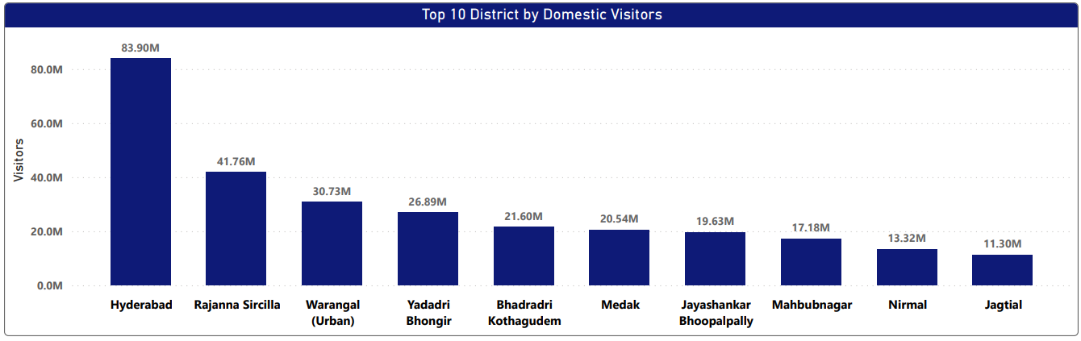
1. List down the top 10 district that have the highest number of domestic visitors overall (2016 - 2019).
Highlights :
Hyderabad has the highest number of Domestic visitors around 84M followed by Rajannna Sircilla 42M and Warangal (Urban) 31M.
Hyderabad is the city that attracts visitors for various purpose beyond just tourism such as education , employment and healthcare.

Slide 6
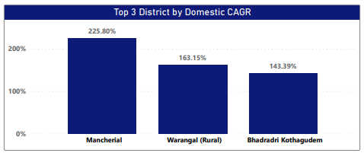
2. List down the top three districts based on the Compound Annual Growth Rate (CAGR) of visitors between (2016 - 2019).
It is used to calculate and determine returns for anything that rise and fall in value ,such as growth rate of visitors.
CAGR = (End value / Start value) ^ 1 / (No. of years) - 1
Highlights :
There has been a consistent increase in the number of visitors to Mancherial , Warangal (Rural) and Bhadradri Khothagudem from 2016 to 2019.

Slide 7
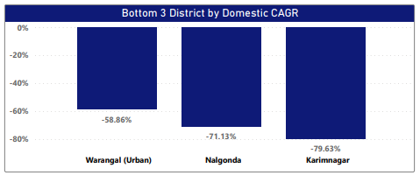
3. List down the bottom three districts based on CAGR of visitors between (2016 – 2019)
Highlights :
The number of the domestic visitors of the three districts mentioned has decreased between 2016 and 2019.
A negative CAGR indicates loses over time rather than gain.
The Reason can be lack of infrastructure , accessibility and tourism initiatives in these districts.

Slide 8
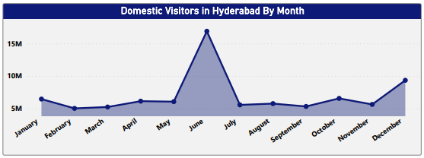
4. What are the peak and low season months for domestic visitors in based on the data from 2016 to 2019 for Hyderabad district ?
Peak Season : June and December
We can see the hype in the month of June (Summer vacation) and December
(vacations).
Low Season : Febraury , March , August , September
The month of February, March , August and September are low season months because children have exams in the month of March and preparation starts from and February and for Professionals its a financial year end and August and September have no major holidays.

Slide 9
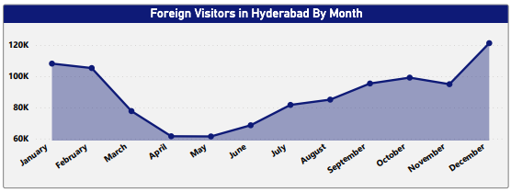
5. What are the peak and low season months for foreign visitors based on the data from 2016 to 2019 for Hyderabad district ?
Peak Season : December to January
The winter vacations for foreign visitors starts from December till the starting of month February.
Low Season : April and May
As per the average trend summers in Hyderabad records above 40degree C temperature which is not so preferred condition.

Slide 10
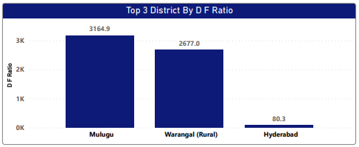
6. Show down the top 3 districts with highest domestic to foreign tourist ratio.
Highlights :
Hyderabad , Warangal (Rural) and Mulugu have attracted the interest of foreign tourists.
These districts are offering visitors blend of history , culture , architecture and local experiences.

Slide 11
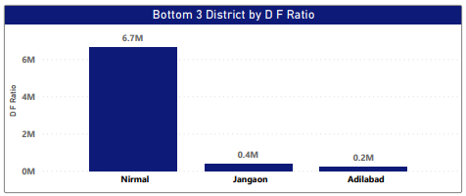
7. Show down the bottom 3 districts with highest domestic to foreign tourist ratio.
Highlights :
Nirmal, Janagaon and Adilabad have attracted the lowest number of foreign tourists.
Despite the presence of historical monuments , waterfalls and other attraction these districts are not popular tourist destinations.
Government should focus on restoration of monuments , natural habitat and construction of roads for better accessibility and marketing.

Slide 12
Secondary Research
Questions

Slide 13
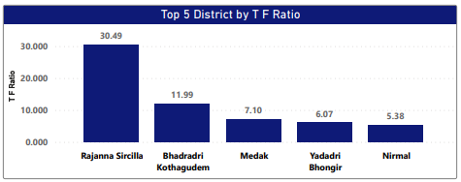
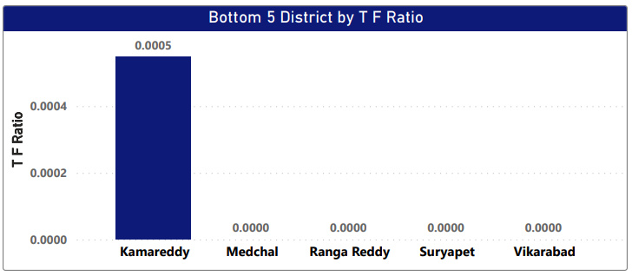
8. List down the top and bottom 5 districts based on the ‘population to tourist footfall ration’ in 2019.
Highlights :
Nirmal has the highest footfall based on population in top five based on population followed by Yadadri Bhognir ,Medak ,Bhadadri kothagudem and Rajanna Sircilla.
Highlights :
In bottom five districts Kamareddy have least footfall ratio and other four districts have 0 footfall ratio.
They lack ability to attract tourist.
Government can provide different facilities and benefit like Tourism hospitality and timeshare to these districts.

Slide 14
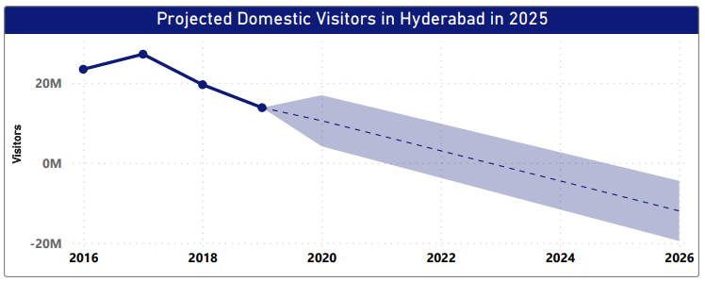
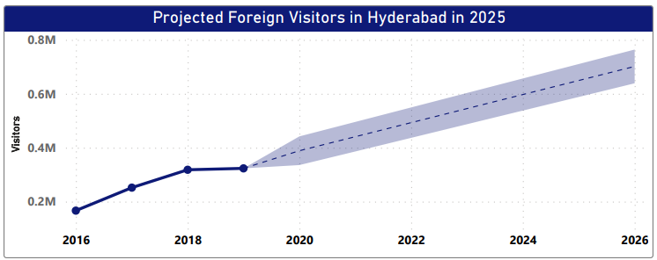
9. What will be the projected number of domestic and foreign tourist in Hyderabad in 2025 based on the growth rate from previous years ?
Domestic Visitors :
Based on the given data , the graph representing the visitors from 2016 to 2019 shows decreasing trend.
In 2019 , there were 13.80M domestic visitors and projected number of the domestic visitors in 2025 is 8.2M.
Foreign Visitors :
Based on the given data , the graph representing the visitors from 2016 to 2019 shows increasing trend.
In 2019 , there were 323K foreign visitors and projected number of the foreign visitors in 2025 is 649K.

Slide 15
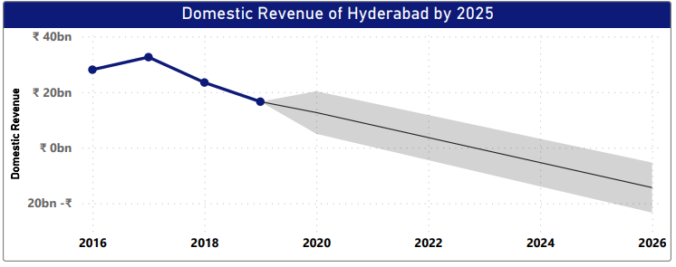
10. What will be the projected number of domestic revenue of Hyderabad in 2025 based on average spend per tourist (approximate data) ?
Domestic Revenue :
Average spend per tourist – 1200 INR
Based on the given data , the graph representing the visitors from 2016 to 2019 shows decreasing trend.
In 2019 ,the revenue generated by domestic visitors was 16.5bn and projected number of the domestic revenue in 2025 is 9.8bn.
The trend shows the revenue may decline and become very low.

Slide 16
11. What will be the projected number of foreign revenue of Hyderabad in 2025 based on average spend per tourist (approximate data) ?
Foreign Revenue :
Average spend per tourist – 5600 INR
Based on the given data , the graph representing the revenue generated by the foreign visitors from 2016 to 2019 shows good hype in trend.
In 2019 , the revenue generated by the foreign tourist was 1.8bn and projected number of the revenue generated by foreign visitors in 2025 is 3.3bn to 3.9bn.

Slide 17
Recommendations

Slide 18
Cultural and
Cooperates Tourism
Folk Performances: Engaging folk dances, music, and traditional arts representing various regions of Telangana will be showcased.
Crafts Exhibition: A curated display of intricate handicrafts, handlooms, and artisanal products will provide insights into the state's skilled craftsmanship.
Cultural Tourism Trails: Guided tours to historical monuments, museums, and cultural landmarks will be organized to provide an immersive cultural experience.
Corporate Showcase: An exhibition area will be dedicated to highlighting Telangana's leading industries, including IT, pharmaceuticals, manufacturing, and more. Special sessions will be organized to present investment prospects in Telangana, offering insights into the state's business-friendly policies and infrastructure.
Adventure sports and other adventure activities where enthusiasts can participate in activities such as trekking, camping, and water sports, showcasing Telangana's potential for adventure tourism.

Slide 19
Q. Dubai has made itself a business hub. Can Hyderabad emulate Dubai model?
Dubai a global business destination, Hyderabad can adopt certain strategies and initiatives to enhance its position as a thriving business hub. Here are some key factors to consider :
Infrastructure Development : Dubai's remarkable infrastructure, including world-class airports, transportation systems, and modern business districts, has been instrumental in attracting businesses. Hyderabad can focus on further developing its infrastructure to facilitate seamless connectivity and efficient logistics .
Business - Friendly Policies : Dubai has a reputation for being business-friendly, with favorable regulations, tax incentives, and simplified procedures for setting up businesses. Hyderabad can streamline its regulatory processes, create a conducive business environment, and introduce policies that attract both domestic and international investments.
Focus on safety and Security : The government could focus on ensuring the safety and security of tourists by providing adequate security measures and imple menting safety guide lines in tourist areas.
Dubai's focus on providing a high standard of living for residents and expatriates has been a contributing factor to its success. Hyderabad can invest in improving the quality of life for its residents by enhancing infrastructure, healthcare, education, entertainment options, and overall livability.

Slide 20
My heartful gratitude to Telangana Government for providing this comprehensive data.
I am confident that the findings from this project will contribute positively to the promotion of tourism in Telangana.
Thank You !

